Slide 1
Unit 4
Natural Language Processing and Artificial Neural Network

Slide 2
Departmental Vision –
Empowering the students to be professionally competent & socially responsible for techno-economic development of society.
Departmental Mission –
To provide quality education enabling students for higher studies, research and entrepreneurship.
b) To inculcate professionalism and ethical values through day to day practices.

Slide 3
What is Natural Language Processing (NLP)
The process of computer analysis of input provided in a human language (natural language), and conversion of this input into a useful form of representation.
The field of NLP is primarily concerned with getting computers to perform useful and interesting tasks with human languages.
The field of NLP is secondarily concerned with helping us come to a better understanding of human language.

Slide 4
Forms of Natural Language
The input/output of a NLP system can be:
written text
speech
We will mostly concerned with written text (not speech).
To process written text, we need:
lexical, syntactic, semantic knowledge about the language
discourse information, real world knowledge
To process spoken language, we need everything required to process written text, plus the challenges of speech recognition and speech synthesis.

Slide 5
Components of NLP
Natural Language Understanding
Mapping the given input in the natural language into a useful representation.
Different level of analysis required:
morphological analysis,
syntactic analysis,
semantic analysis,
discourse analysis, …
Natural Language Generation
Producing output in the natural language from some internal representation.
Different level of synthesis required:
deep planning (what to say),
syntactic generation
NL Understanding is much harder than NL Generation. But, still both of them are hard.

Slide 6
Why NL Understanding is hard?
Natural language is extremely rich in form and structure, and very ambiguous.
How to represent meaning,
Which structures map to which meaning structures.
One input can mean many different things. Ambiguity can be at different levels.
Lexical (word level) ambiguity -- different meanings of words
Syntactic ambiguity -- different ways to parse the sentence
Interpreting partial information -- how to interpret pronouns
Contextual information -- context of the sentence may affect the meaning of that sentence.
Many input can mean the same thing.
Interaction among components of the input is not clear.

Slide 7
Knowledge of Language
Phonology – concerns how words are related to the sounds that realize them.
Morphology – concerns how words are constructed from more basic meaning units called morphemes. A morpheme is the primitive unit of meaning in a language.
Syntax – concerns how can be put together to form correct sentences and determines what structural role each word plays in the sentence and what phrases are subparts of other phrases.
Semantics – concerns what words mean and how these meaning combine in sentences to form sentence meaning. The study of context-independent meaning.

Slide 8
Knowledge of Language (cont.)
Pragmatics – concerns how sentences are used in different situations and how use affects the interpretation of the sentence.
Discourse – concerns how the immediately preceding sentences affect the interpretation of the next sentence. For example, interpreting pronouns and interpreting the temporal aspects of the information.
World Knowledge – includes general knowledge about the world. What each language user must know about the other’s beliefs and goals.

Slide 9
Ambiguity
I made her duck.
How many different interpretations does this sentence have?
What are the reasons for the ambiguity?
The categories of knowledge of language can be thought of as ambiguity resolving components.
How can each ambiguous piece be resolved?
Does speech input make the sentence even more ambiguous?
Yes – deciding word boundaries

Slide 10
Ambiguity (cont.)
Some interpretations of : I made her duck.
I cooked duck for her.
I cooked duck belonging to her.
I created a toy duck which she owns.
I caused her to quickly lower her head or body.
I used magic and turned her into a duck.
duck – morphologically and syntactically ambiguous:
noun or verb.
her – syntactically ambiguous: dative or possessive.
make – semantically ambiguous: cook or create.
make – syntactically ambiguous:
Transitive – takes a direct object. => 2
Di-transitive – takes two objects. => 5
Takes a direct object and a verb. => 4

Slide 11
Ambiguity in a Turkish Sentence
Some interpretations of: Adamı gördüm.
I saw the man.
I saw my island.
I visited my island.
I bribed the man.
Morphological Ambiguity:
ada-m-ı ada+P1SG+ACC
adam-ı adam+ACC
Semantic Ambiguity:
gör to see
gör to visit
gör to bribe

Slide 12
Resolve Ambiguities
We will introduce models and algorithms to resolve ambiguities at different levels.
part-of-speech tagging -- Deciding whether duck is verb or noun.
word-sense disambiguation -- Deciding whether make is create or cook.
lexical disambiguation -- Resolution of part-of-speech and word-sense ambiguities are two important kinds of lexical disambiguation.
syntactic ambiguity -- her duck is an example of syntactic ambiguity, and can be addressed by probabilistic parsing.

Slide 13
Resolve Ambiguities (cont.)
I made her duck
S S
NP VP NP VP
I V NP NP I V NP
made her duck made DET N
her duck

Slide 14
Models to Represent Linguistic Knowledge
We will use certain formalisms (models) to represent the required linguistic knowledge.
State Machines -- FSAs, FSTs, HMMs, ATNs, RTNs
Formal Rule Systems -- Context Free Grammars, Unification Grammars, Probabilistic CFGs.
Logic-based Formalisms -- first order predicate logic, some higher order logic.
Models of Uncertainty -- Bayesian probability theory.

Slide 15
Algorithms to Manipulate Linguistic Knowledge
We will use algorithms to manipulate the models of linguistic knowledge to produce the desired behavior.
Most of the algorithms we will study are transducers and parsers.
These algorithms construct some structure based on their input.
Since the language is ambiguous at all levels,
these algorithms are never simple processes.
Categories of most algorithms that will be used can fall into following categories.
state space search
dynamic programming

Slide 16
Language and Intelligence
Turing Test
Computer Human
Human Judge
Human Judge asks tele-typed questions to Computer and Human.
Computer’s job is to act like a human.
Human’s job is to convince Judge that he is not machine.
Computer is judged “intelligent” if it can fool the judge
Judgment of intelligence is linked to appropriate answers to questions from the system.

Slide 17
NLP - an inter-disciplinary Field
NLP borrows techniques and insights from several disciplines.
Linguistics: How do words form phrases and sentences? What constraints the possible meaning for a sentence?
Computational Linguistics: How is the structure of sentences are identified? How can knowledge and reasoning be modeled?
Computer Science: Algorithms for automatons, parsers.
Engineering: Stochastic techniques for ambiguity resolution.
Psychology: What linguistic constructions are easy or difficult for people to learn to use?
Philosophy: What is the meaning, and how do words and sentences acquire it?

Slide 18
Some Buzz-Words
NLP – Natural Language Processing
CL – Computational Linguistics
SP – Speech Processing
HLT – Human Language Technology
NLE – Natural Language Engineering
SNLP – Statistical Natural Language Processing
Other Areas:
Speech Generation, Text Generation, Speech Understanding, Information Retrieval,
Dialogue Processing, Inference, Spelling Correction, Grammar Correction,
Text Summarization, Text Categorization,

Slide 19
Some NLP Applications
Machine Translation – Translation between two natural languages.
See the Babel Fish translations system on Alta Vista.
Information Retrieval – Web search (uni-lingual or multi-lingual).
Query Answering/Dialogue – Natural language interface with a database system, or a dialogue system.
Report Generation – Generation of reports such as weather reports.
Some Small Applications –
Grammar Checking, Spell Checking, Spell Corrector

Slide 20
Brief History of NLP
1940s –1950s: Foundations
Development of formal language theory (Chomsky, Backus, Naur, Kleene)
Probabilities and information theory (Shannon)
1957 – 1970s:
Use of formal grammars as basis for natural language processing (Chomsky, Kaplan)
Use of logic and logic based programming (Minsky, Winograd, Colmerauer, Kay)
1970s – 1983:
Probabilistic methods for early speech recognition (Jelinek, Mercer)
Discourse modeling (Grosz, Sidner, Hobbs)
1983 – 1993:
Finite state models (morphology) (Kaplan, Kay)
1993 – present:
Strong integration of different techniques, different areas.

Slide 21
Natural Language Understanding
Words
Morphological Analysis
Morphologically analyzed words (another step: POS tagging)
Syntactic Analysis
Syntactic Structure
Semantic Analysis
Context-independent meaning representation
Discourse Processing
Final meaning representation

Slide 22
Natural Language Generation
Meaning representation
Utterance Planning
Meaning representations for sentences
Sentence Planning and Lexical Choice
Syntactic structures of sentences with lexical choices
Sentence Generation
Morphologically analyzed words
Morphological Generation
Words

Slide 23
Morphological Analysis
Analyzing words into their linguistic components (morphemes).
Morphemes are the smallest meaningful units of language.
cars car+PLU
giving give+PROG
geliyordum gel+PROG+PAST+1SG - I was coming
Ambiguity: More than one alternatives
flies fly_{VERB}+PROG
fly_{NOUN}+PLU
adamı adam+ACC - the man (accusative)
adam+P1SG - my man
ada+P1SG+ACC - my island (accusative)

Slide 24
Morphological Analysis (cont.)
Relatively simple for English. But for some languages such as Turkish, it is more difficult.
uygarlaştıramadıklarımızdanmışsınızcasına
uygar-laş-tır-ama-dık-lar-ımız-dan-mış-sınız-casına
uygar +BEC +CAUS +NEGABLE +PPART +PL +P1PL +ABL +PAST +2PL +AsIf
“(behaving) as if you are among those whom we could not civilize/cause to become civilized”
+BEC is “become” in English
+CAUS is the causative voice marker on a verb
+PPART marks a past participle form
+P1PL is 1st person plural possessive marker
+2PL is 2nd person plural
+ABL is the ablative (from/among) case marker
+AsIf is a derivational marker that forms an adverb from a finite verb form
+NEGABLE is “not able” in English
Inflectional and Derivational Morphology.
Common tools: Finite-state transducers

Slide 25
Part-of-Speech (POS) Tagging
Each word has a part-of-speech tag to describe its category.
Part-of-speech tag of a word is one of major word groups
(or its subgroups).
open classes -- noun, verb, adjective, adverb
closed classes -- prepositions, determiners, conjuctions, pronouns, particples
POS Taggers try to find POS tags for the words.
duck is a verb or noun? (morphological analyzer cannot make decision).
A POS tagger may make that decision by looking the surrounding words.
Duck! (verb)
Duck is delicious for dinner. (noun)

Slide 26
Lexical Processing
The purpose of lexical processing is to determine meanings of individual words.
Basic methods is to lookup in a database of meanings -- lexicon
We should also identify non-words such as punctuation marks.
Word-level ambiguity -- words may have several meanings, and the correct one cannot be chosen based solely on the word itself.
bank in English
yüz in Turkish
Solution -- resolve the ambiguity on the spot by POS tagging (if possible) or pass-on the ambiguity to the other levels.

Slide 27
Syntactic Processing
Parsing -- converting a flat input sentence into a hierarchical structure that corresponds to the units of meaning in the sentence.
There are different parsing formalisms and algorithms.
Most formalisms have two main components:
grammar -- a declarative representation describing the syntactic structure of sentences in the language.
parser -- an algorithm that analyzes the input and outputs its structural representation (its parse) consistent with the grammar specification.
CFGs are in the center of many of the parsing mechanisms. But they are complemented by some additional features that make the formalism more suitable to handle natural languages.

Slide 28
Semantic Analysis
Assigning meanings to the structures created by syntactic analysis.
Mapping words and structures to particular domain objects in way consistent with our knowledge of the world.
Semantic can play an import role in selecting among competing syntactic analyses and discarding illogical analyses.
I robbed the bank -- bank is a river bank or a financial institution
We have to decide the formalisms which will be used in the meaning representation.

Slide 29
Knowledge Representation for NLP
Which knowledge representation will be used depends on the application -- Machine Translation, Database Query System.
Requires the choice of representational framework, as well as the specific meaning vocabulary (what are concepts and relationship between these concepts -- ontology)
Must be computationally effective.
Common representational formalisms:
first order predicate logic
conceptual dependency graphs
semantic networks
Frame-based representations

Slide 30
Discourse
Discourses are collection of coherent sentences (not arbitrary set of sentences)
Discourses have also hierarchical structures (similar to sentences)
anaphora resolution -- to resolve referring expression
Mary bought a book for Kelly. She didn’t like it.
She refers to Mary or Kelly. -- possibly Kelly
It refers to what -- book.
Mary had to lie for Kelly. She didn’t like it.
Discourse structure may depend on application.
Monologue
Dialogue
Human-Computer Interaction

Slide 31
Natural Language Generation
NLG is the process of constructing natural language outputs from non-linguistic inputs.
NLG can be viewed as the reverse process of NL understanding.
A NLG system may have two main parts:
Discourse Planner -- what will be generated. which sentences.
Surface Realizer -- realizes a sentence from its internal representation.
Lexical Selection -- selecting the correct words describing the concepts.

Slide 32
Machine Translation
Machine Translation -- converting a text in language A into the corresponding text in language B (or speech).
Different Machine Translation architectures:
interlingua based systems
transfer based systems
How to acquire the required knowledge resources such as mapping rules and bi-lingual dictionary? By hand or acquire them automatically from corpora.
Example Based Machine Translation acquires the required knowledge (some of it or all of it) from corpora.

Slide 33
Learning
Learning denotes changes in a system that ... enable a system to do the same task … more efficiently the next time.” - Herbert Simon
“Learning is constructing or modifying representations of what is being experienced.” - Ryszard Michalski
“Learning is making useful changes in our minds.” - Marvin Minsky
“
“Machine learning refers to a system capable of the autonomous acquisition and integration of knowledge.”

Slide 34
Learning
Learning denotes changes in a system that enable the system to do the same task more efficiently next time.
Learning is essential for unknown environments.
Learning modifies the agent's decision mechanisms to improve performance.
learning is important for agents to deal with
unknown environments
changes

Slide 35
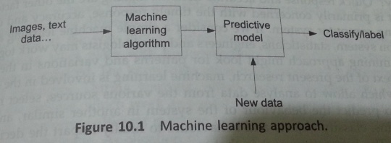
Machine Learning(ML)
ML is building and exploring methods for programming computers to make them learn.
ML has a knowledge base and set of rules(Prediction rules) that helps in making a decision.

Slide 36
Learning Concepts
Labeled Data –
Given a specific sets of inputs we are aware of the output.
The data can be sampled into categories. The samples are labeled which can be positive or negative.
Positive Sample – It provides information that belongs to a particular category.
Negative Sample - Information does not belong to that category.
Eg:- Students categorized under university.
2. Unlabeled Data –
When the category or possible outcome of data is absent it is called unlabeled data.

Slide 37
Training Set:-
Compromises positive and negative samples.
Test Set-
It measures the accuracy of the classifier or learning approach.

Slide 38
Types/ Forms Of Learning
Supervised Learning
It is the learning with labeled data. It is like a supervisor telling an agent whether the categorization is correct or not.
The aim of this type of learning is to find a function that maps input to output.
Unsupervised Learning
The agent tries to learn from patterns without corresponding output values.
Unlabeled samples are used here.
3. Semi supervised Learning -
Combines both labeled and unlabeled samples.
4. Reinforcement Learning – unlabeled samples
the agent does not know the exact output for an input, but it receives feedback on the desirability of its behavior
the feedback can come from an outside entity, the environment, or the agent itself

Slide 39
Paradigms/ Methods and Models Of Learning
Following are the major paradigms of machine learning:
Rote Learning
Induction
Clustering
Analogy
Discovery
Reinforcement
Genetics algorithm

Slide 40
Paradigms/ Methods and Models Of Learning (Contd..)
Rote Learning – Learning by memorization.
It has one-to-one mapping from inputs to the stored representation.
Here the values are stored so that these are not re-computed.
The storing or memorizing some of the results improves performance of the system, when in future, similar computations are made.
Saves time and avoid recomputation.
Eg:- Paging and caching
2 Induction – Learning from examples.
Form/type of supervised learning.
It uses specific examples to reach a conclusion.
Concepts are learned from labeled data.

Slide 41
Paradigms of Learning
3. Clustering – Discovering similar group.
Unsupervised, inductive learning.
Natural classes/groups are found for unlabeled data.
4. Analogy –
It shows correspondence/ coreleation between two representations.
5. Discovery – Learning without the help from teacher.
Unsupervised Learning
Unsupervised data is discovered and no specific goal is given.

Slide 42
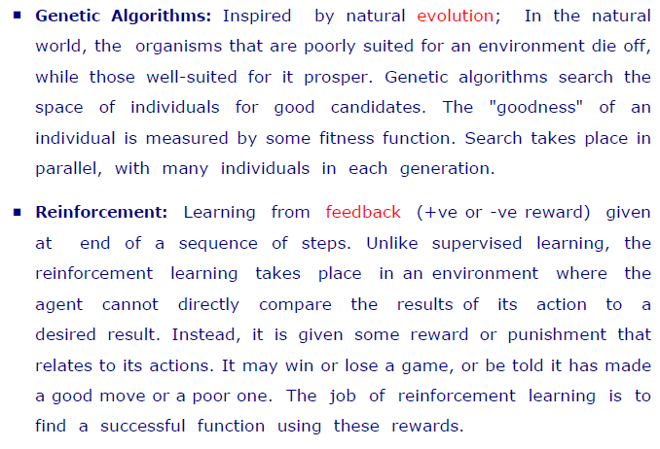
Paradigms of Learning

Slide 43
Learning from Observation
This type of learning includes the following:-
Learning from Agents
Inductive Learning
Learning from Decision Trees

Slide 44
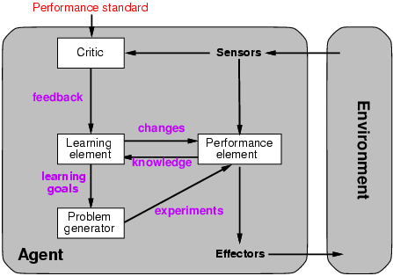
Learning Agent
The learning agent observes the behavior pattern in the environment and takes action accordingly.

Slide 45
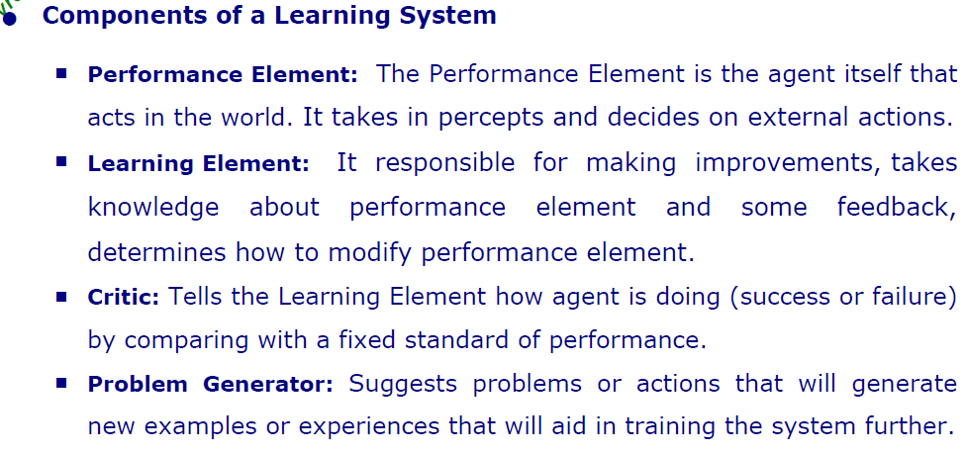
Learning Agent

Slide 46
Inductive Learning
It offers to establish a connection between pieces of information.
Eg:- A small kid learns about new things.
Here, a conclusion is made after observing a few samples.
Sometimes conclusion may be wrong as it may based on limited information.(Eg:- Paris)
Works on induction principle.
Consider that A posses property P. X belongs to A then X also possess property P.

Slide 47
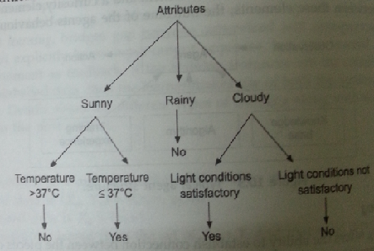
Decision Tree Learning
It is an inference method.
The learned function is represented by decision tree.
From programming viewpoint, it is representation of if - then rules.
Eg:- Decision tree for playing cricket.

Slide 48
Decision Tree Learning(Contd..)
This representation is suitable for problems in which instances are represented as attribute values.
Used when target function has discrete output values.
At every node a decision is taken.

Slide 49
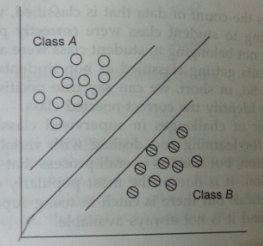
Supervised Learning
Eg:- Document Classification
The classification problem consist of following entities:
Labeled data set ( Some available documents and their classes is known)
Classifier – A program that maps input documents to appropriate classes.

Slide 50
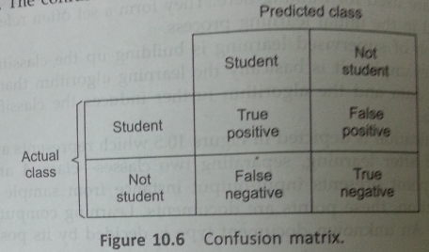
Supervised Learning(Contd..)
Classifier and the decision making engine should minimize false positive and false negatives.
False Positive:- Stands for result yes i.e classified in particular group wrongly.

Slide 51
Confusion/Error matrix –
Represents performance of an classifier.
Challenges in Supervised Learning:-
Supervised data is expensive and it is not always possible to get it.

Slide 52
Unsupervised Learning
The data may not be always be properly labeled.
Huge unlabeled data is present that should be used during training.
Learning based on unlabeled data is called as unsupervised learning.
Understanding and Visualization -
Here learning is based on similarities and differences which are visible.
Eg:- A child is able to separate cars from boats or ships.
Dissimilarity Measure – i.e cars have wheels whereas boats do not have wheels.
Based on visualization, objects can be categorized.

Slide 53
Unsupervised Learning (Contd..)
Unsupervised learning performs hierarchical groupings(clustering).
Clustering mechanism results in grouping of the objects based on their similarities and differences.
Hierarchical Clustering –
Here objects are arranged into hierarchical structure
in such a way that similar objects are grouped together.
Non- Hierarchical Clustering –
It partitions the data set into disjoint clusters.
Relationships between clusters is undetermined.

Slide 54
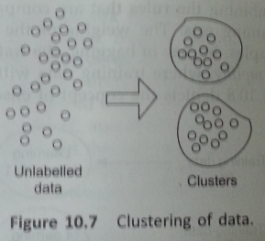
Unsupervised Learning

Slide 55
Semi - Supervised Learning
In real life scenarios, we try to learn from both supervised and unsupervised learning methods.
Semi-supervised learning tries to learn from both labeled and unlabeled data.
Let U be set of unlabeled data
L set of labeled data
The learning approach tries to identify unlabeled data U with reference to labeled data L and keeps on labeling the unlabeled data.

Slide 56
Reinforcement Learning(RL)
RL is an machine learning approach where agent explores an environment.
The agent perceives its current state and takes actions.
The environment in return provides a reward as positive or negative.
The algorithm tries to find a policy for maximizing reward for the agent.
Definition- “RL is a computational approach to learning where an agent tries to maximize the total amount of reward it receives when interacting with complex uncertain environment”.

Slide 57
RL Problem
Its is a goal directed problem and agent uses its decision making capabilities.
It is a supervised learning approach.
RL emphasizes learning from interaction with its environment.
RL uses a formal framework for defining interaction between a learning agent and its environment in terms of states, actions and rewards.

Slide 58
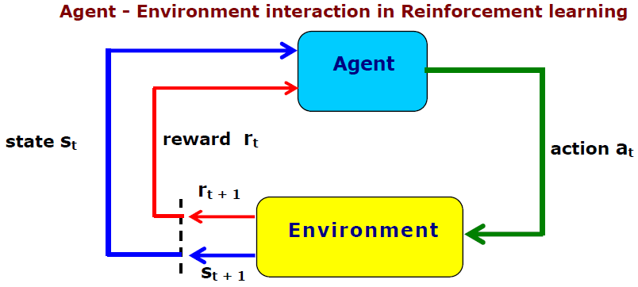
Agent – Environment Interaction

Slide 59
Agent – Environment Interaction
For every interaction, agent gets some input i.
This i gives brief detail about the current state.
Based on this input agent takes an action a.
Every action when executed results in the transition to a new state and a value associated with this transition is given to the agent by means of a signal known as reinforcement signal (r – reward factor).
The goal is to choose the actions that maximize the final summation of r values.

Slide 60
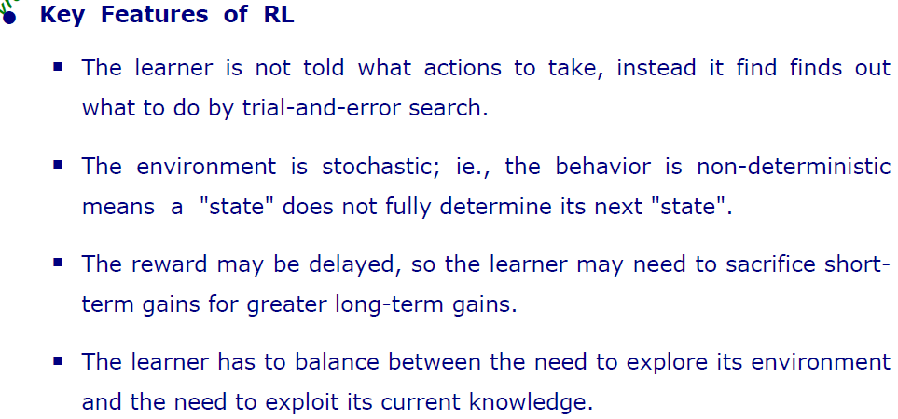

Slide 61
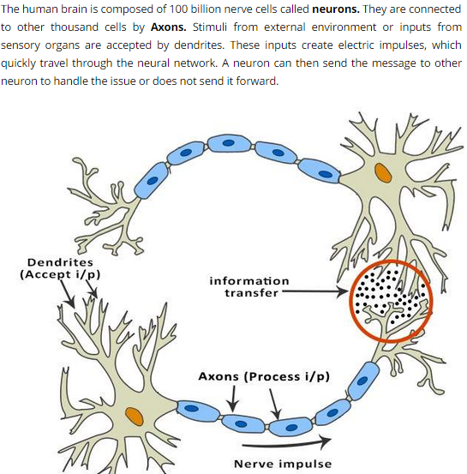
Artificial Neural Network(ANN) Based Learning

Slide 62
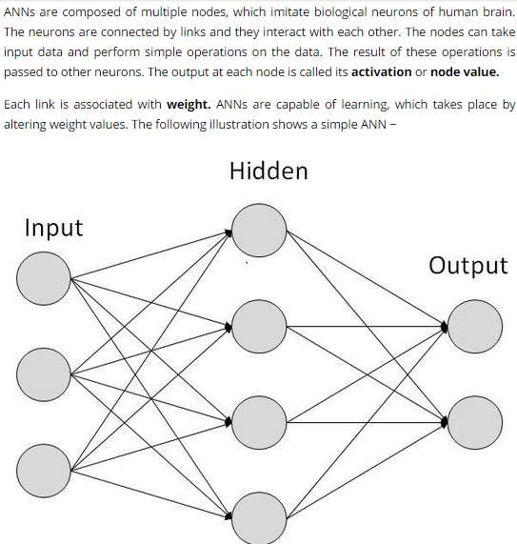

Slide 63
ANN has different inputs which are weighted as per the strength of the signal.
ANN’s are mathematical function which determines the activation of the neuron.
ANNs combine artificial neurons to process information.

Slide 64
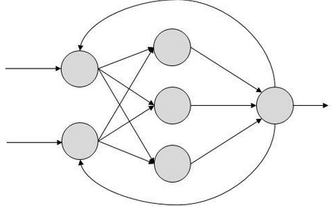
ANN – Back Propagation Algorithm
Here artificial neurons send their signals forward and then the errors are propagated backwards.
This algorithm is supervised and hence error can be calculated.
The user provide the algo. examples of I/p and o/p they want and then the difference between the actual output and the expected output is calculated. This is error.
The goal is to adjust the
weight in order to minimize
the errors.

Slide 65
This algorithm has two passes –
1. Forward Pass :-
Here hidden layer uses the input values which computes the neurons output.
These outputs are the input to the next hidden layer.
Finally the output value is calculated.
2. Backward Pass:-
In the output layer error is calculated for each neuron. The error is propagated and weights are adjusted to get desired values.

Slide 66
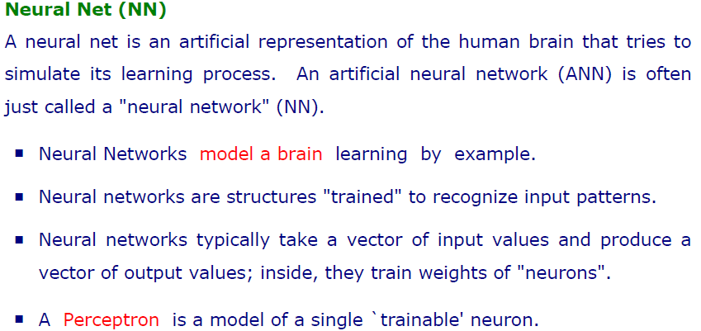

Slide 67
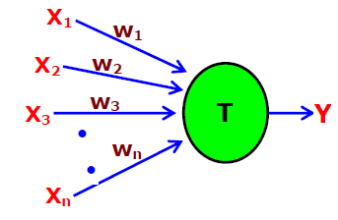
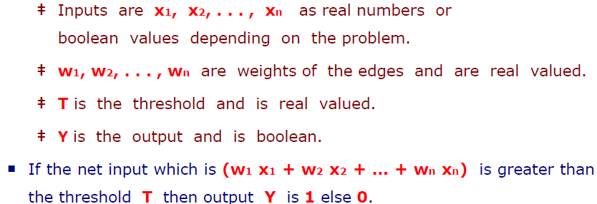
ANN
Perceptron is a single model of trainable ‘neuron’

